Slide 1
12.12.19
“jtr”: Jitter Measurement for Ultra Messaging, etc.
Steve Ford
sford@informatica.com
Notes:
A couple of weeks ago, I had some questions about jitter in a Unix environment. Basically a user was going to do some measurements, and I wanted to be able to respond intelligently to the inevitable questions, so I needed to ramp up my own expertise. These tools are relatively simple and easy to understand. They can be used during evaluations in much the same way that “mtools” are used: to establish baseline numbers of the user’s equipment.

Slide 2
“jtr” Package is Open Source
Public GitHub repo: https://github.com/UltraMessaging/jtr (many technical details there)
You need a valid UM license to run the UM tests.
But there are some interesting tests that don’t use UM.
Can also produce pretty graphs if you have GnuPlot installed.
Goal: measure the time to do some interesting thing (a sample) and see how much that time varies across large numbers of samples. That variation is ”jitter”.
General approach: measure a time sample and increment a corresponding histogram bucket. Do this a million times. Graph the resulting histogram.
A million samples don’t need a million histogram buckets. Each bucket represents 10 nanoseconds. So a sample time of 98 ns will increment bucket number 9, which represents the number of samples with times between 90-99 ns. Some of these tests use as few as 200 buckets, others as many as 1500.
IMPORTANT: all graphs use logarithmic Y axis. This emphasizes small counts.
Notes:
Logarithmic graphs can be misleading because it emphasizes small counts. You can have something that looks like a large grouping of outliers, but they actually represent a tiny percentage of the total samples.

Slide 3
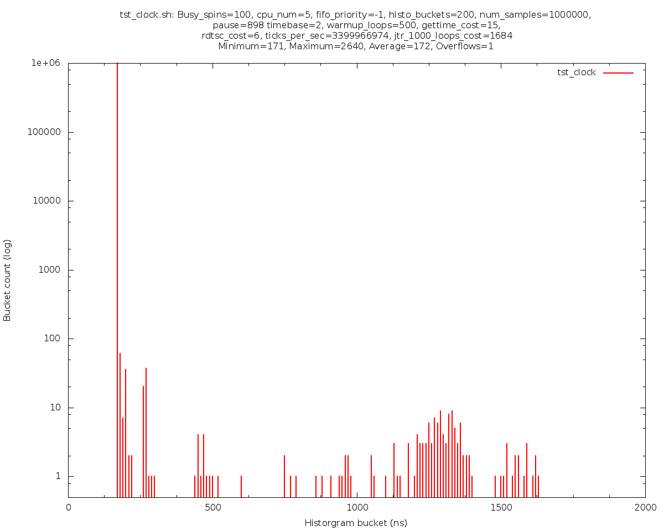
Let’s jump right in! – Timing a “for” Loop
All tests run on host “Crush”, tuned for low jitter.
General algorithm: for (i = -500; i < 1,000,000; i++) { start = timestamp; do_thing_we_want_to_time; end = timestamp; if (i >= 0) increment_histogram(end – start); one_microsecond_delay_just_for_fun; }
Note the 500 “warmup” cycles.
For this test, “thing we want to time” is: for (j = 0; j < 100; j++) {}; Don’t compile with optimization!
Look at all that jitter! One loop took 2.6 MICROseconds!
Those “for” loops must be really SUCK!
But at least it isn’t my fault!!! ... or is it?
Notes:
The “-500” is to give 500 warmup cycles. This gets the instruction and data caches loaded up and gives the system a chance to settle. I’ll mention the “one_microsecond_delay_just_for_fun” a little later.
Don’t enable the optimizer when compiling! Otherwise the empty for loop will be optimized away.
Overflows=1, Maximum=2640 – a 2.6 microsecond sample is not shown on the graph.

Slide 4
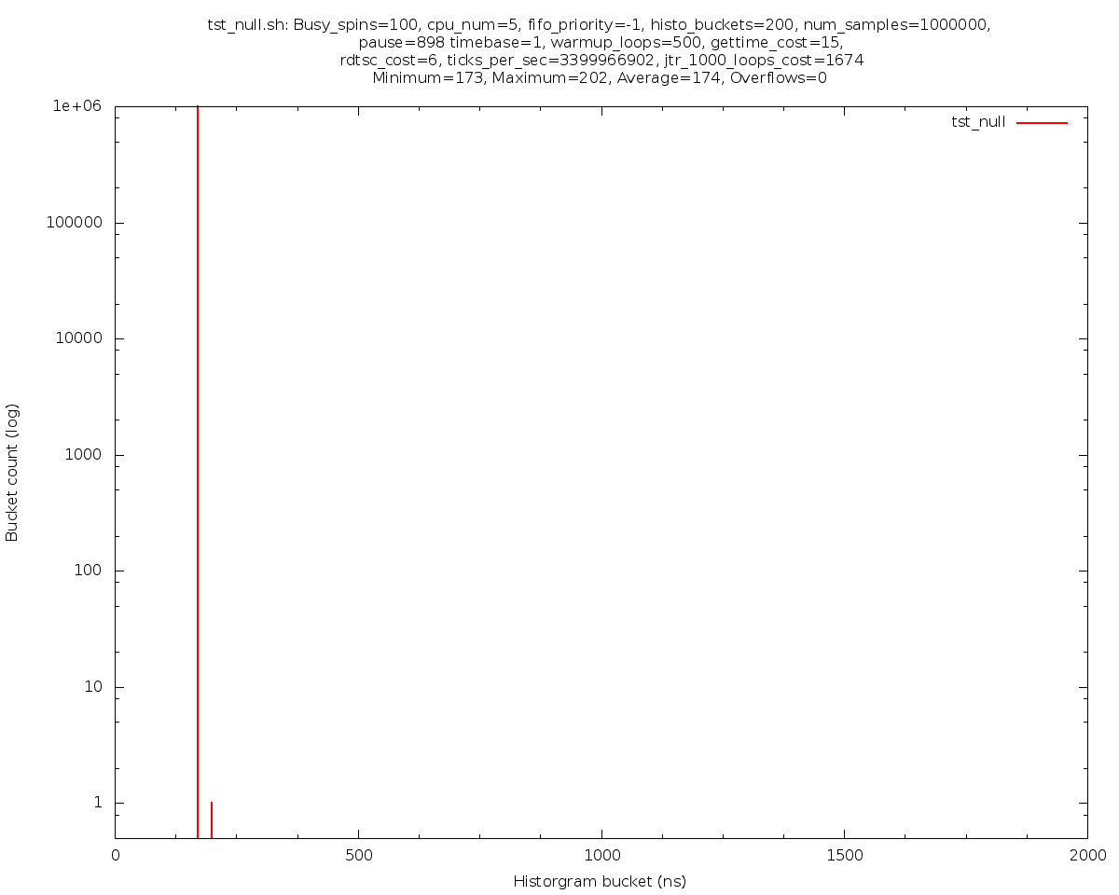
Try Again, with RDTSC
Measuring the same 100-cycle “for” loop!
999,999 samples in the 170 ns bucket, 1 sample in the 200 ns bucket.
Where did the jitter go???
Previous test took timestamps with clock_gettime(). This test took timestamps with RDTSC: asm volatile ("rdtsc" : "=a" (lo), "=d" (hi));
Glibc (clock_gettime) was written for correctness and performance, where “performance” means *average* execution time. Occasional outliers? They don’t care.
But RDTSC can have problems. Not generally applicable. Requires calibration. Not guaranteed consistent across CPUs or C States, especially on old OS/Glibc/hardware. BE CAREFUL!
https://en.wikipedia.org/wiki/Time_Stamp_Counter
Unless noted, rest of tests (carefully) use RDTSC.
Notes:
This is the same test, still sampling the time required to run a 100-cycle “for” loop. But the jitter has melted away. The only change from the previous test is how I take timestamps. I changed from clock_gettime to the RDTSC instruction. The “for” loop didn’t have jitter, the clock_gettime call did! The average overheads of those two methods are surprisingly similar: clock_gettime costs about 15 ns, and RDTSC costs about 6 ns. But clock_gettime apparently has some kind of spin lock that can sometimes contend with something. Using it introduces a lot of jitter.

Slide 5
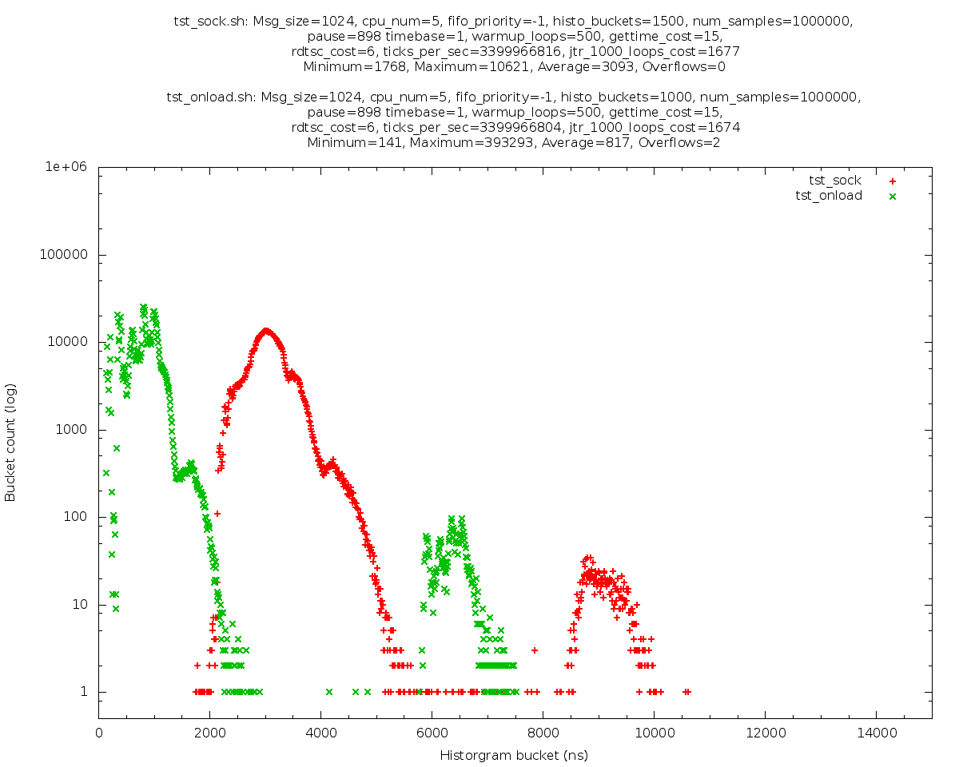
Kernel Socket vs. Onload Socket
Two tests superimposed on the same graph. Green=Onload, red=kernel. (No UM code, just socket calls.)
Average onload=.8 usec, Average kernel=3.1 usec (3.8 x) Good job, Onload.
But look at the maximums! Max onload=10.6 usec Max kernel=393 usec! (127 x) GREAT job, Onload!!!
Both kernel driver and Onload written by Solarflare; code is probably similar. Kernel adds overhead and outliers.
By the way, the “one_microsecond_delay_just_for_fun” mentioned earlier? It lets the packet exit the NIC before sending the next. This avoids queuing and blocking.
I have no idea what the double-hump is all about.
I did NOT spend time learning about how to optimize Onload. Probably room for improvement, but beyond the scope of this investigation.
Notes:
This is not an advertisement for Solarflare’s Onload, but it does show why latency-sensitive customers use it. A socket send with Onload averages about a quarter of the time to do a socket send with a kernel driver. But look at the maximum times. The worst-case kernel time was close to half a millisecond! The worst-case Onload was only 10 microseconds. Fair warning: there may be things I could tune in the kernel to reduce the jitter of a kernel call. And the same is true for Onload. I suspect a guru could improve both sets of numbers.

Slide 6
Ultra Messaging Smart Source
Red points: Smart Source with 100% source-side loss. I.e. NO SOCKET CALL (UM code only).
Remember, this is a logarithmic scale. The buckets over 200 all have counts under 10, most with just 1 or 2.
Average send time is 82 ns.
99.900% are below 100 ns 99.990% are below 180 ns 99.999% are below 670 ns (i.e. all but 10 samples)
Green lines: a second test superimposed on the first, but instead of calling UM send, just does a 48-cycle “for” loop. This is the “control” to show system jitter.
Does UM’s pattern of latency outliers remind you of anything?
Notes:
Now let’s look at the UM Smart Source ”send” call with 100% source-side loss – no socket call at all. UM code only. Out of a million samples, all but about 100 are under 200 ns. And the average is 82 ns. Pretty good! About the green line. It is a separate test, but instead of calling Smart Source send, it’s just a 48-cycle “for” loop. Why 48? I chose that number so that the “for” loop would take about the same amount of time as the average UM send call. So it represents “system”-level jitter. I’ve run this test many times, and the results are always very similar. UM send has some jitter.

Slide 7
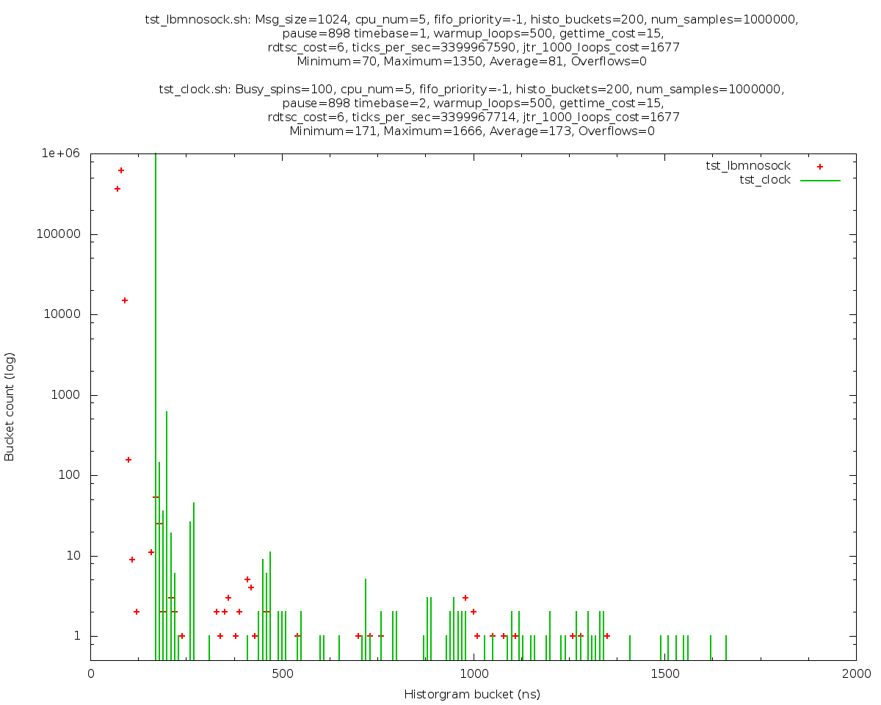
Timestamps Source of UM Jitter
Red=UM send (no socket). Same-ish as previous slide.
Green=100-cycle “for” loop, with clock_gettime (slide 3). I.e. the green lines are the clock_gettime-induced jitter.
Not quite apples-to-apples since different average times.
The UM jitter is because we need to take a timestamp for the LBT-RM protocol operation.
We have considered changing UM to use RDTSC, but the jitter induced by our current timestamp is insignificant compared to that of Onload. Given the lack of guarantees associated with RDTSC, the risk is not worth the benefit.
Be aware that the timestamp is taken AFTER the datagram is sent on the socket, so the jitter does not affect time-to-wire.
Notes:
Here’s a case where graphical visualizations really helped me. Just staring at tables of numbers, I might not have been struck by the similarity between UM jitter and clock_gettime jitter from slide 3. My first thought when I saw the similarity was that my measurement program must be using clock_gettime, but it wasn’t. Then I remembered that LBT-RM needs you to take a timestamp during a send so that things like session messages and TSNIs can be timed properly. Sure enough, it calls gettimeofday, which is implemented very similarly to clock_gettime.

Slide 8
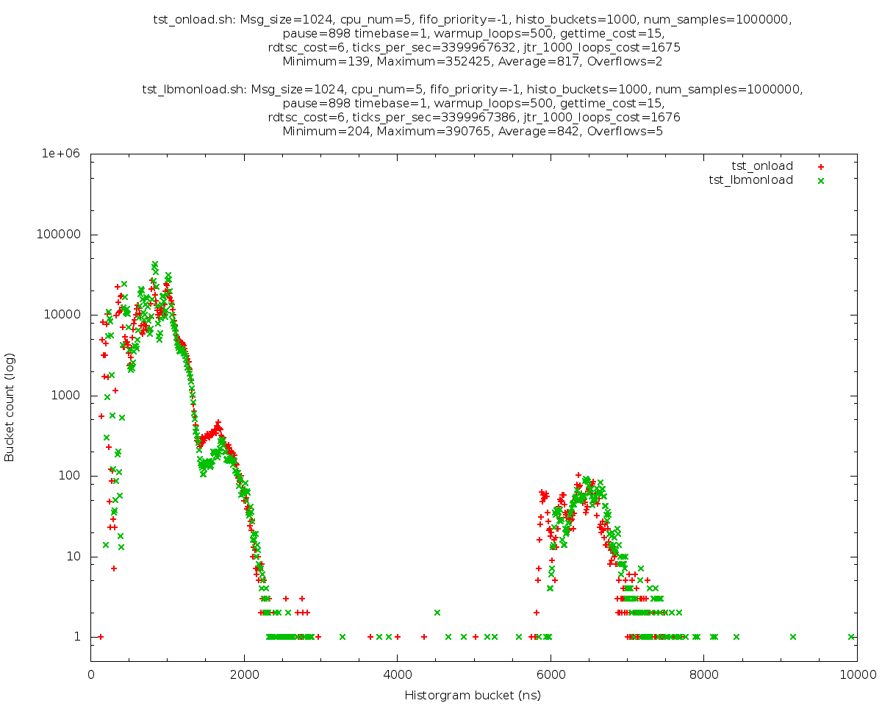
UM over Onload vs. Onload Only
Red=Onload simple socket send (no UM). green=UM with Onload.
Interesting that even though UM’s average is 82 ns, the difference between Onload and Onload+UM averages is only 25 ns.
Notes:
UM over Onload vs. calling Onload directly – not much difference. And both have maximum values that are very high, leading me to believe that Onload also calls a glibc timestamping function.

Slide 9
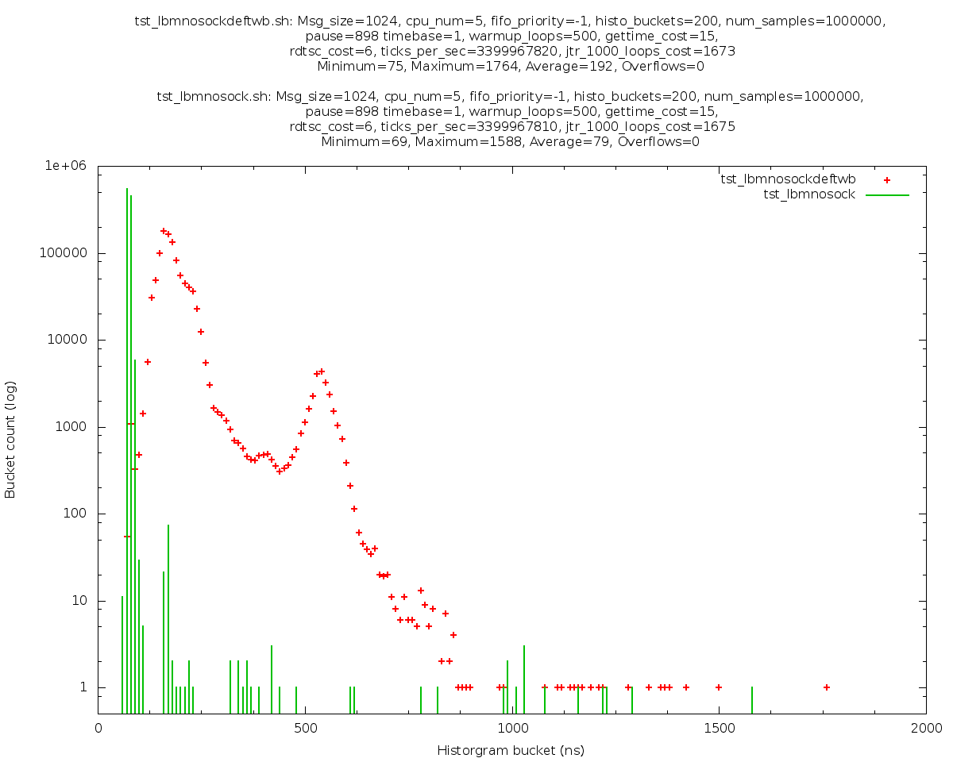
Smart Source with Large Buffers
Green = Smart Source (no socket), as before: source transport_lbtrm_smart_src_transmission_ window_buffer_count 8 (16KB allocated)
Red = Smart Source with default buffer: source transport_lbtrm_smart_src_transmission_ window_buffer_count 16384 (32MB allocated)
Transmission window buffer grew from 16K to 32Meg.
Code path is identical, but data cache is continually being wiped out due to messages being written across the whole buffer.
At low message rates, small transmission window buffers can be OK. But at high message rates, need large buffers so that NAKs can be serviced.
Notes:
When I started this project, I saw very strange jitter profiles for Smart Source sends. With a little help from my friends, we figured out that the default LBT-RM transmission window buffer is really big, which had the effect of keeping the data cache invalidated much of the time, forcing fetches from memory. Setting the buffer very small gives the really good jitter profiles you saw in earlier slides. Here’s what the default buffer size looks like in terms of the jitter profile. Still pretty good, but you do pay a price.

Slide 10
Many More Graphs!
You can generate all 33 graphs using: ./tstall.sh ./plotall.sh
In general, “tst_.*.sh” scripts run tests and output measurement data.
Each test is run 3 times.
Most of the tests also include a “null” data collection (empty “for” loop) of about the same duration.
Raw histogram counts are written to “.gp” files (for consumption by Gnuplot). They are also interesting to examine while looking at the corresponding graph.
Each “tst_...” script also produces a “.txt” file containing percentiles.
“plot_*.sh” scripts take that measurement data and produce “.png” graphs.
Most of the plot scripts take data from different tests to compare the results.
Gnuplot can also be used in an interactive mode that lets you experiment with display parameters.
Let me know if you want copies of my full test run results.

Slide 11
Low-Jitter Tuning
I only scratched the surface of eliminating system-level jitter:
Isolating cores from the scheduler.
Moving IRQs off of the isolated cores.
Task-setting each jitter-sensitive thread to its own core.
Running “tickless” (nohz_full boot parameter).
There are many other possible steps at: https://www.kernel.org/doc/Documentation/kernel-per-CPU-kthreads.txt
But it is impossible to completely eliminate all jitter. Many jitter reduction steps might have consequences that unacceptable for many use cases (e.g. making transmission window buffers so small that NAKs cannot be effectively serviced at high message rates).
So, how much did my efforts benefit me?

Slide 12
Ultra Messaging Smart Source
This is a re-visit of slide 6.
Red points: Smart Source with 100% source-side loss. I.e. NO SOCKET CALL (UM code only).
Green lines: a second test superimposed on the first, but instead of calling UM send, just does a 48-cycle “for” loop. This is the “control” to show system jitter.
Notes:
Just a reminder of Smart Source “no socket” send vs null “for” loop.

Slide 13
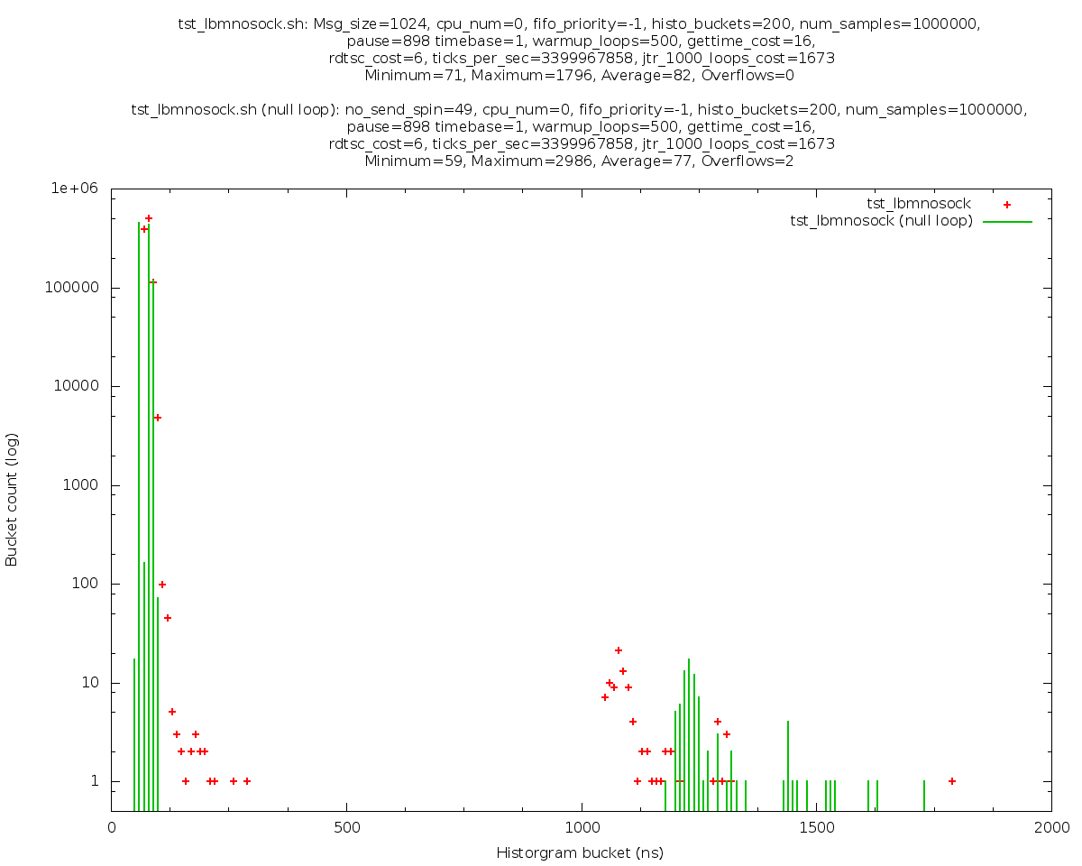
Smart Source on Core Zero
Here’s the same thing on Core 0.
The thread is pinned, but the core is not isolated. And interrupts are allowed, including the 1000 Hz ticks.
Red points: Smart Source with 100% source-side loss. I.e. NO SOCKET CALL (UM code only).
Green lines: a 49-cycle “for” loop.
Max is about 3 us. For the “for” loop. Measured with RDTSC.
Note that the system was not particularly busy during this test. I’m sure the outliers would be more severe if lots of other people were using it.
Notes:
I predicted it would be worse.

Slide 14
Next Steps?
Persistence (traditional sources/Smart Sources/IPC).
Test with receivers.
Compare RM to RU, IPC, and SMX with different numbers of receivers.
ULB with different numbers of receivers.
Test round-trip (ping-pong).
Simple socket (no UM).
UM (traditional sources/Smart Sources/IPC/SMX, streaming/persistence)
Request/response
Java and .NET?
Don’t hold your breath on any of these! Not actively working on extensions right now, but happy to accept pull requests (hint hint). :-)

